Slide 1
Cloud Computing
Topic 3: Concepts and Models
NOTICE: Slides are extracted from Cloud Computing: Concepts, Technology & Architecture by Thomas Erl; Ricardo Puttini; Zaigham Mahmood and other resources.
© PRENTICE HALL

Slide 2
Learning Outcomes
Identify and describe the major roles and boundaries in the Cloud environment
Explain the Cloud environment characteristics
Analyse the different Cloud delivery models to determine their suitability in a given scenario
Evaluate the different Cloud deployment models to determine their suitability in a given scenario
Prescribed text: Erl, Chapter 4: Fundamental Concepts and Models
Varia, J. (2011). Architecting for the Cloud: Best Practices. Retrieved from https://s3.amazonaws.com/awsmedia/AWS_Cloud_Best_Practices.pdf

Slide 3
Concepts and Models
4.1 Roles and Boundaries
4.2 Cloud Characteristics
4.3 Cloud Delivery Models
4.4 Cloud Deployment Models

Slide 4
4.1. Roles and Boundaries
Cloud Provider
Cloud Consumer
Cloud Service Owner
Cloud Resource Administrator
Organizational Boundary
Trust Boundary

Slide 5
Cloud Provider
The organization that provides cloud-based IT resources is the cloud provider.
The cloud provider is further tasked with any required management and administrative duties to ensure the on-going operation of the overall cloud infrastructure.
Cloud providers normally own the IT resources that are made available for lease by cloud consumers; however, some cloud providers also “resell” IT resources leased from other cloud providers.

Slide 6
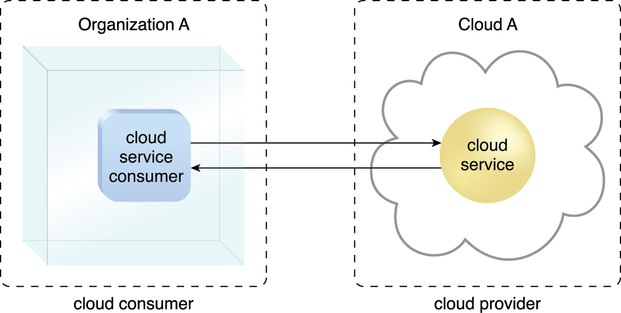
Cloud Consumer
A cloud consumer is an organization (or a human) that has a formal contract or arrangement with a cloud provider to use IT resources made available by the cloud provider.
cloud consumer uses a cloud service consumer to access a cloud service.
organizations or humans shown remotely accessing cloud-based IT resources are considered cloud consumers.
Figure 4.1 A cloud consumer (Organization A) interacts with a cloud service from a cloud provider
(that owns Cloud A). Within Organization A, the cloud service consumer is being used to
access the cloud service.

Slide 7
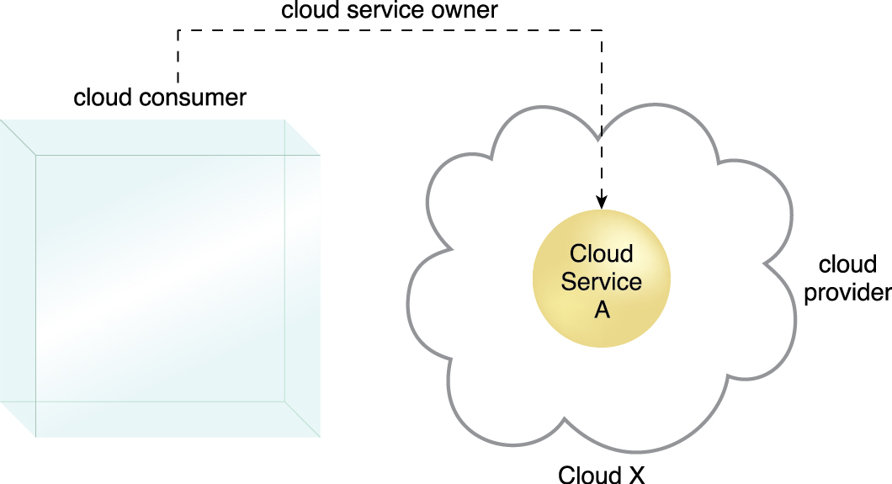
Cloud Service Owner
The person or organization that legally owns a cloud service is called a cloud service owner.
Figure 4.2 A cloud consumer can be a cloud service owner when it deploys its own service in a cloud.

Slide 8
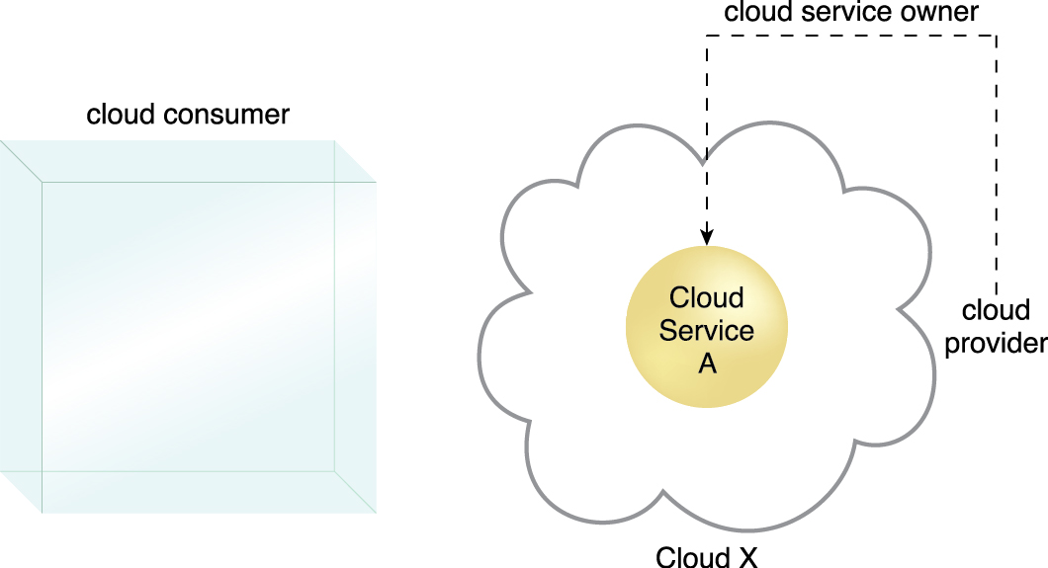
Cloud Service Owner (cont..)
Figure 4.3 A cloud provider becomes a cloud service owner if it deploys its own cloud service,
typically for other cloud consumers to use.

Slide 9
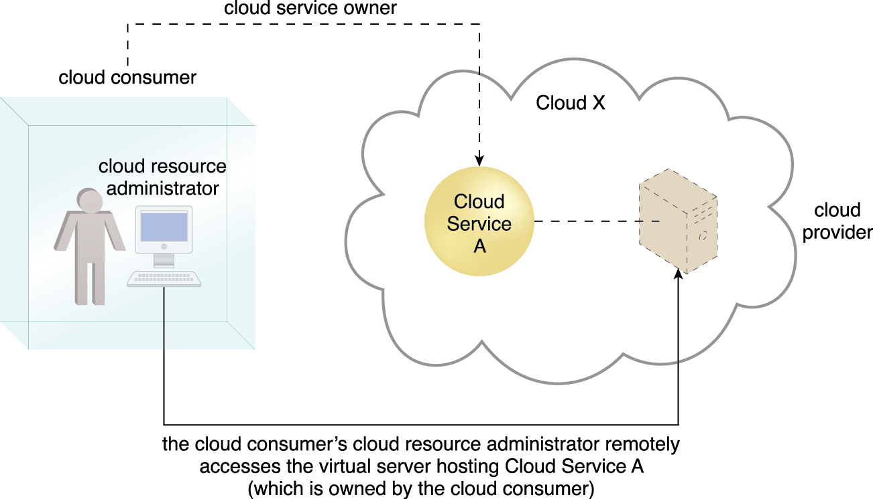
Cloud Resource Administrator
A cloud resource administrator is the person or organization responsible for administering a cloud-based IT resource (including cloud services).
Figure 4.4 A cloud resource administrator can be with a cloud consumer organization and administer
remotely accessible IT resources that belong to the cloud consumer.

Slide 10
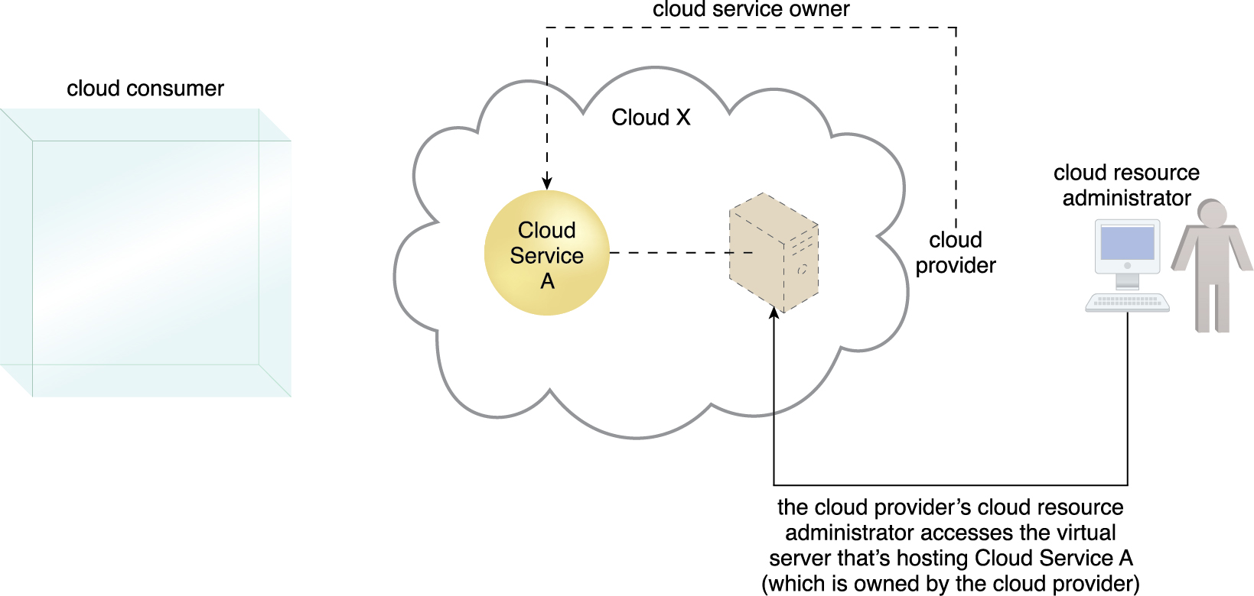
Cloud Resource Administrator
cloud resource administrator can be (or belong to) the cloud consumer or cloud provider of the cloud within which the cloud service resides.
Figure 4.5 A cloud resource administrator can be with a cloud provider organization for which it can
administer the cloud provider’s internally and externally available IT resources.

Slide 11
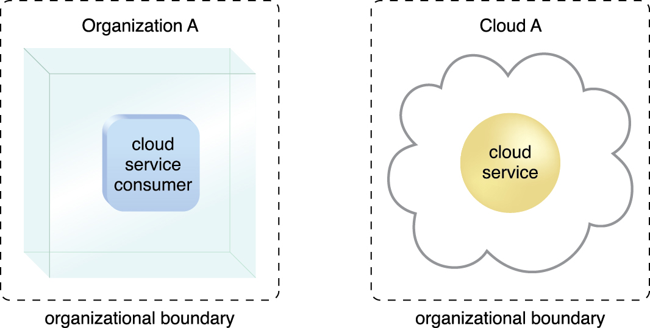
Organizational Boundary
An organizational boundary represents the physical perimeter that surrounds a set of IT resources that are owned and governed by an organization.
Figure 4.6 Organizational boundaries of a cloud consumer (left), and a cloud provider (right),
represented by a broken line notation.

Slide 12
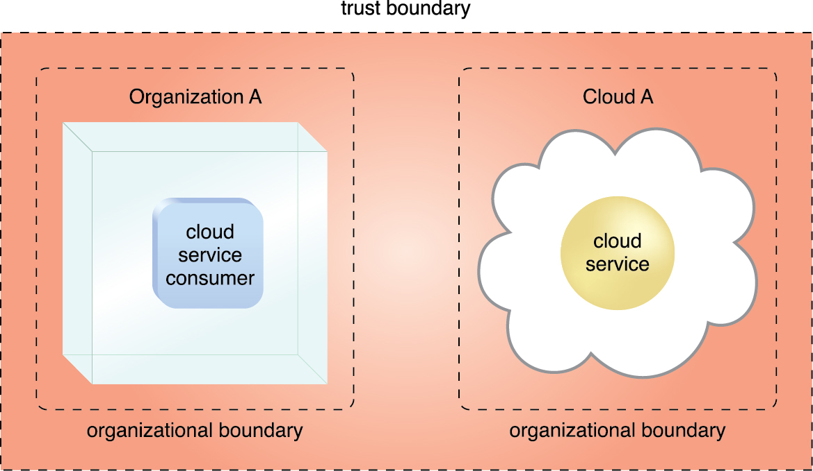
Trust Boundary
A trust boundary is a logical perimeter that typically spans beyond physical boundaries to represent the extent to which IT resources are trusted
Figure 4.7 An extended trust boundary encompasses the organizational boundaries of the cloud provider
and the cloud consumer.

Slide 13
4.2. Cloud Characteristics
Six specific characteristics are common to the majority of cloud environments:
on-demand usage
ubiquitous access
multitenancy (and resource pooling)
elasticity
measured usage
Resiliency (NIST is excluded)

Slide 14
On-Demand Usage
A cloud consumer can unilaterally access cloud-based IT resources giving the cloud consumer the freedom to self-provision these IT resources or on-demand usage.
Ubiquitous access represents the ability for a cloud service to be widely accessible.
Establishing ubiquitous access for a cloud service can require support for a range of devices, transport protocols, interfaces, and security technologies.
Ubiquitous Access

Slide 15
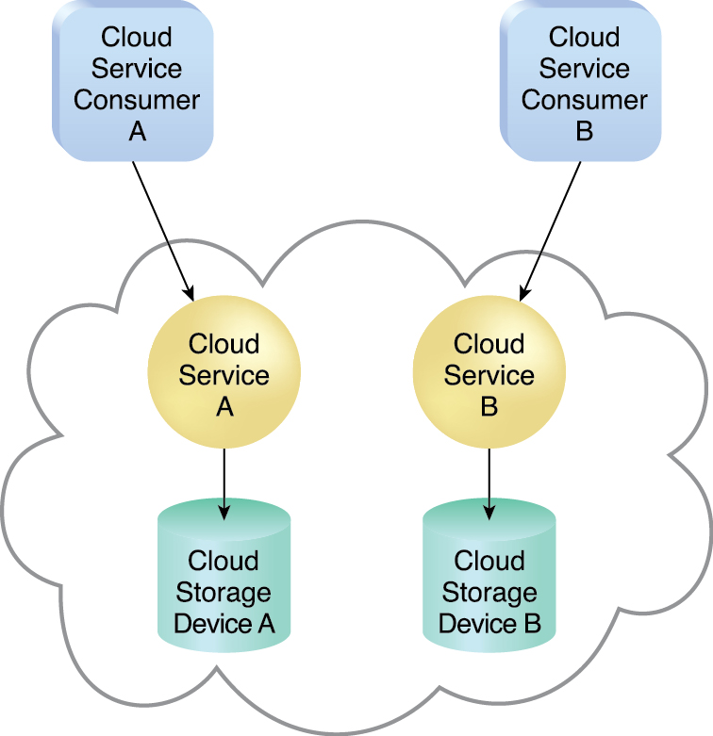
Multitenancy
Characteristic of a software program that enables an instance of the program to serve different consumers (tenants) whereby each is isolated from the other, is referred to as multitenancy.
Figure 4.8 In a single-tenant environment, each cloud consumer has a separate IT resource instance.

Slide 16
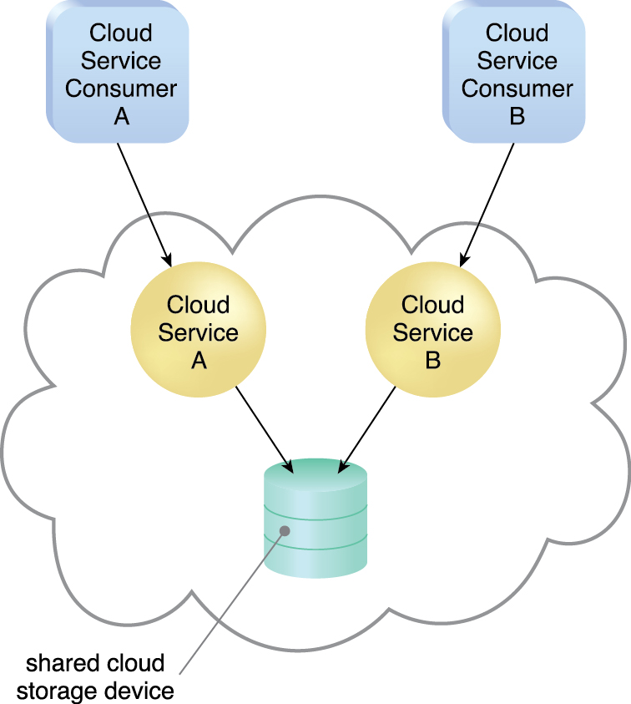
Multitenancy (cont..)
Multitenancy allows several cloud consumers to use the same IT resource or its instance while each remains unaware that it may be used by others.
Figure 4.9 In a multitenant environment, a single instance of an IT resource, such as a cloud storage device, serves multiple consumers.

Slide 17
Elasticity
Elasticity is the automated ability of a cloud to transparently scale IT resources, as required in response to runtime conditions or as pre-determined by the cloud consumer or cloud provider.
Elasticity is often considered a core justification for the adoption of cloud computing.
measured usage characteristic represents the ability of a cloud platform to keep track of the usage of its IT resources, primarily by cloud consumers.
Can charge a cloud consumer only for the IT resources actually used and/or for the timeframe during which access to the IT resources was granted.
is closely related to the on-demand characteristic.
Measured usage is not limited to tracking statistics for billing purposes. It also encompasses the general monitoring of IT resources and related usage reporting
Measured Usage

Slide 18
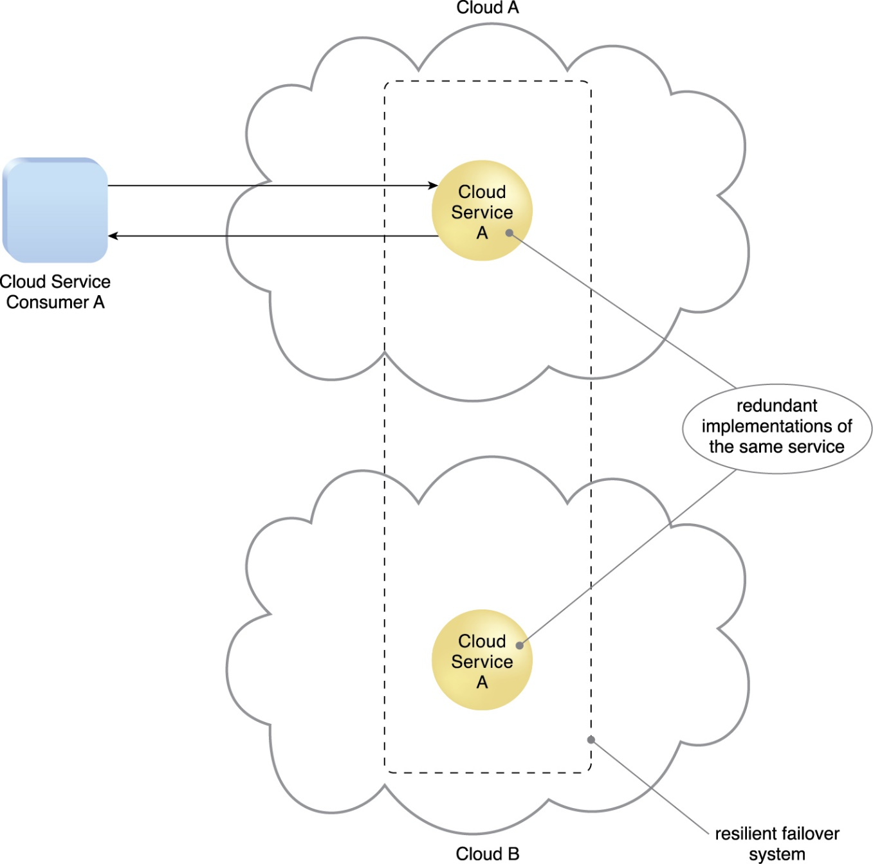
Resiliency
Resilient computing is a form of failover that distributes redundant implementations of IT resources across physical locations.
resiliency can refer to redundant IT resources within the same cloud services(but in different physical locations) or across multiple clouds.
Figure 4.10 A resilient system in which Cloud B hosts a redundant implementation of Cloud Service A to provide failover in case Cloud Service A on Cloud A becomes unavailable.

Slide 19
4.3. Cloud Delivery Models
A cloud delivery model represents a specific, pre-packaged combination of IT resources offered by a cloud provider.
Three common cloud delivery models have become widely established and formalized:
Infrastructure-as-a-Service (IaaS)
Platform-as-a-Service (PaaS)
Software-as-a-Service (SaaS)
Note:
Many specialized variations of the three base cloud delivery models have emerged, each comprised of a distinct combination of IT resources. Some examples include:
Storage-as-a-Service
Database-as-a-Service
Security-as-a-Service
Communication-as-a-Service
Integration-as-a-Service
Testing-as-a-Service
Process-as-a-Service

Slide 20
Infrastructure-as-a-Service (IaaS)
IaaS delivery model represents a self-contained IT environment comprised of infrastructure-centric IT resources that can be accessed and managed via cloud service-based interfaces and tools.
Can include hardware, network, connectivity, operating systems, and other “raw” IT resources.
Are typically virtualized and packaged into bundles that simplify up-front runtime scaling and customization of the infrastructure.
General purpose of an IaaS environment is to provide cloud consumers with a high level of control and responsibility over its configuration and utilization.
Used by cloud consumers that require a high level of control over the cloud-based environment they intend to create.
IaaS environments are generally offered as freshly initialized virtual instances.
A central and primary IT resource within a typical IaaS environment is the virtual server.
Virtual servers are leased by specifying server hardware requirements, such as processor capacity, memory, and local storage space.

Slide 21
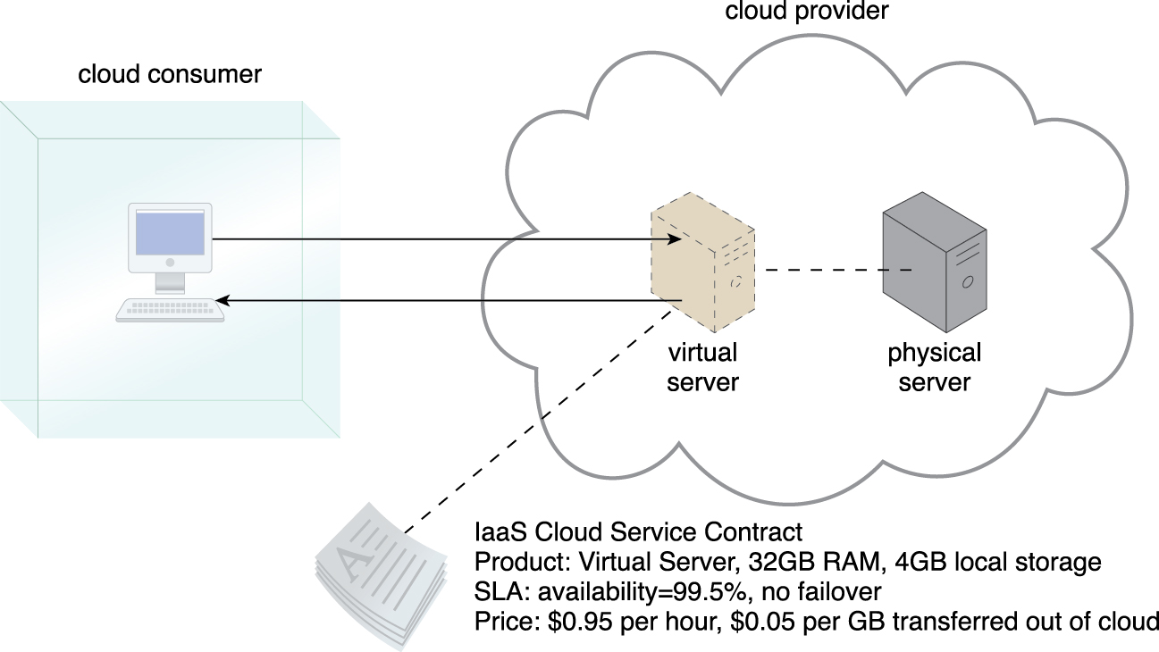
Infrastructure-as-a-Service (IaaS)
Figure 4.11 A cloud consumer is using a virtual server within an IaaS environment. Cloud consumers are
provided with a range of contractual guarantees by the cloud provider, pertaining to characteristics
such as capacity, performance, and availability.

Slide 22
Platform-as-a-Service (PaaS)
PaaS delivery model represents a pre-defined “ready-to-use” environment typically comprised of already deployed and configured IT resources.
Common reasons a cloud consumer would use and invest in a PaaS environment include:
The cloud consumer wants to extend on-premise environments into the cloud for scalability and economic purposes.
The cloud consumer uses the ready-made environment to entirely substitute an on-premise environment.
The cloud consumer wants to become a cloud provider and deploys its own cloud services to be made available to other external cloud consumers.
By working within a ready-made platform, the cloud consumer is spared the administrative burden of setting up and maintaining the bare infrastructure IT resources provided via the IaaS model.
The cloud consumer is granted a lower level of control over the underlying IT resources that host and provision the platform.
PaaS products are available with different development stacks. For example, Google App Engine offers a Java and Python-based environment.

Slide 23
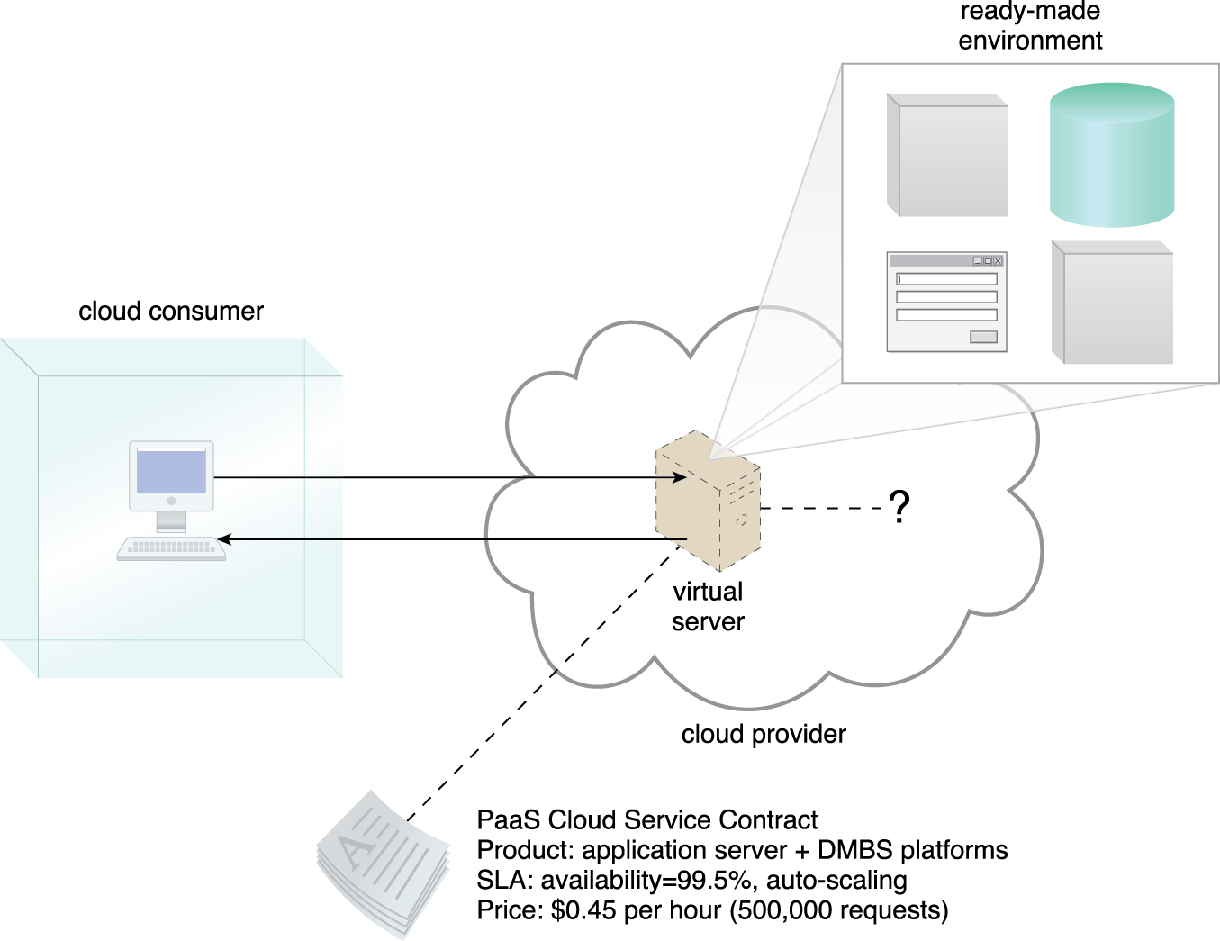
Platform-as-a-Service (PaaS)
Figure 4.12 A cloud consumer is accessing a ready-made PaaS environment. The question mark indicates that the cloud consumer is intentionally shielded from the implementation details of the platform.

Slide 24
Software-as-a-Service (SaaS)
A software program positioned as a shared cloud service and made available as a “product” or generic utility represents the typical profile of a SaaS offering.
The SaaS delivery model is typically used to make a reusable cloud service widely available (often commercially) to a range of cloud consumers.
A cloud consumer is generally granted very limited administrative control over a SaaS implementation.

Slide 25
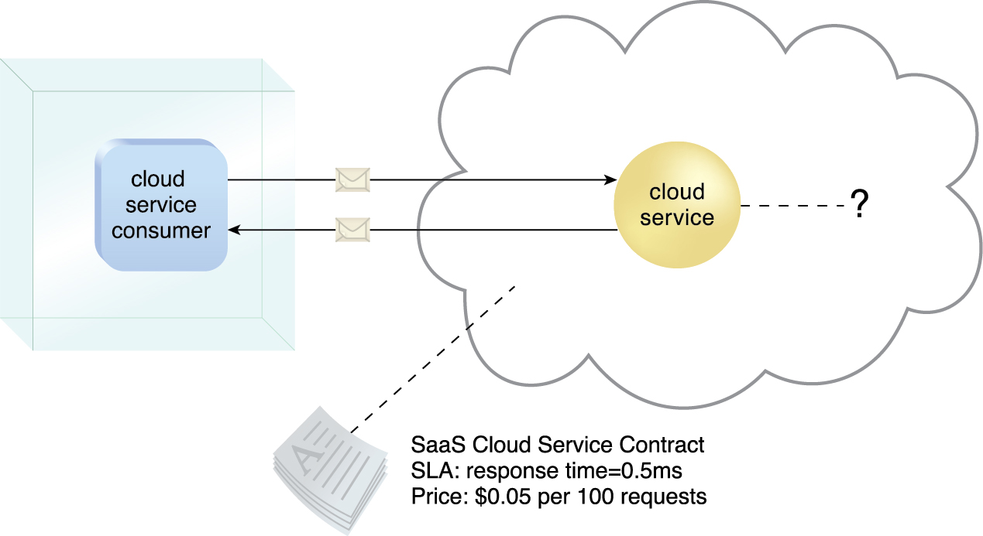
Software-as-a-Service (SaaS)
Figure 4.13 The cloud service consumer is given access the cloud service contract, but not to any
underlying IT resources or implementation details.

Slide 26
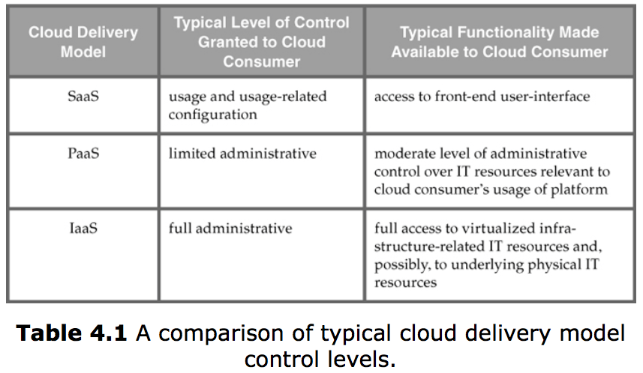
Comparing Cloud Delivery Models

Slide 27
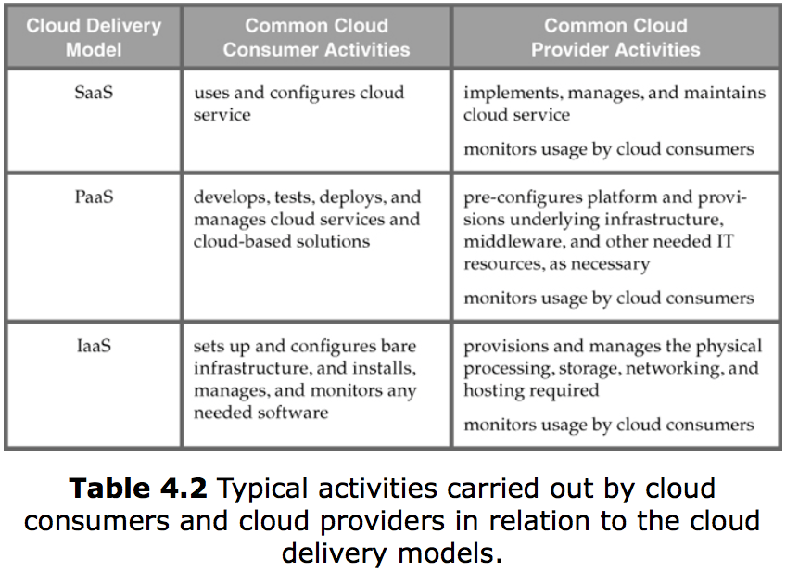
Comparing Cloud Delivery Models

Slide 28
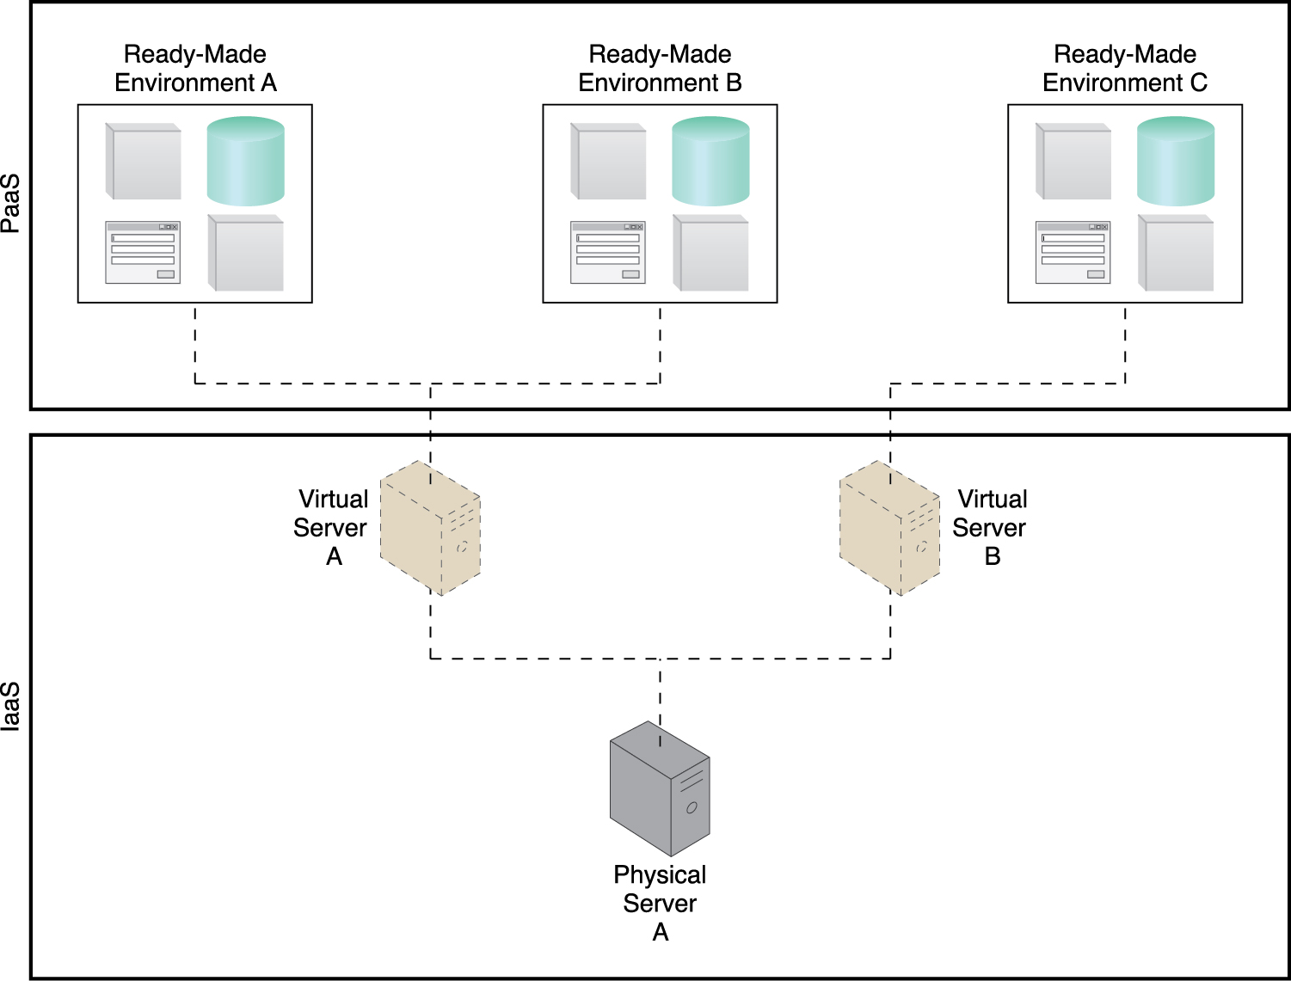
Combining Cloud Delivery Models
IaaS + PaaS
Figure 4.14 A PaaS environment based on the IT resources provided by an underlying IaaS environment.

Slide 29
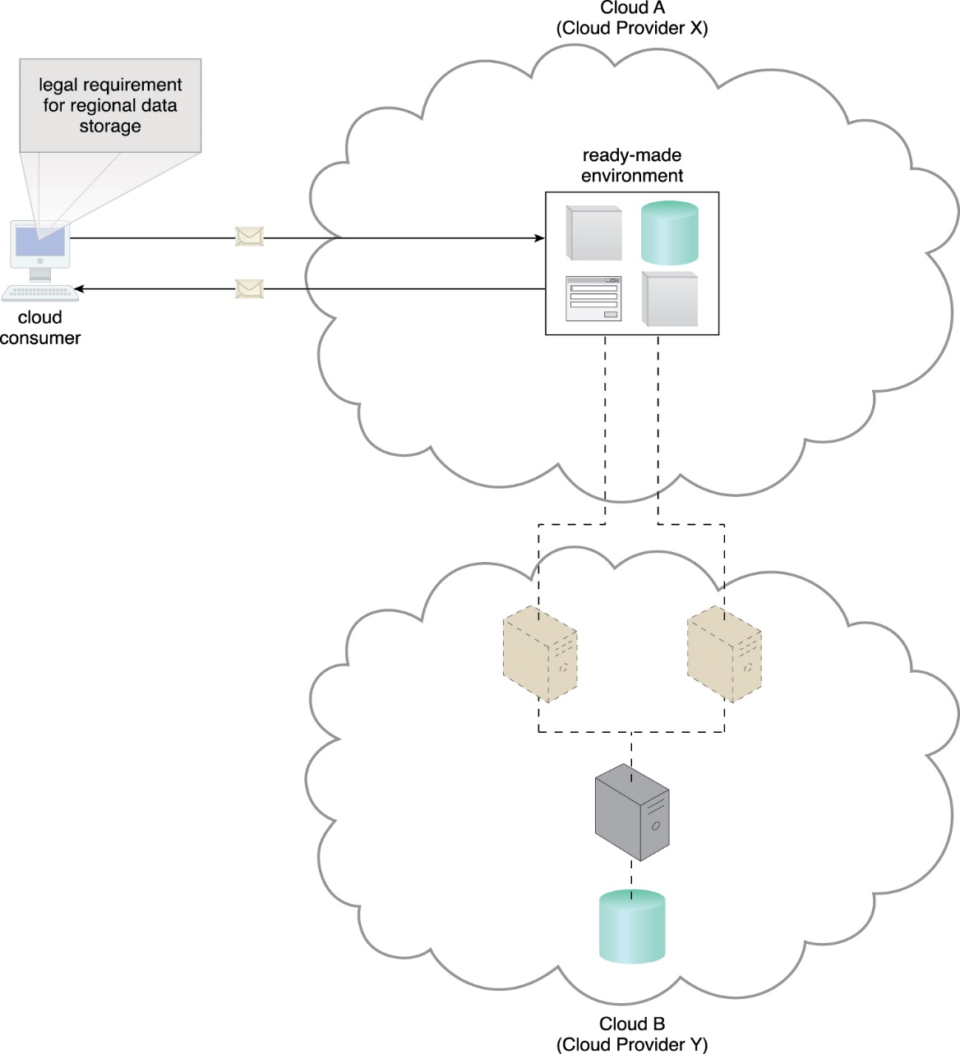
Combining Cloud Delivery Models
IaaS + PaaS
Cloud provider offering the PaaS environment choose to lease an IaaS environment from a different cloud provider.
Figure 4.15 An example of a contract between Cloud Providers X and Y, in which services offered by Cloud Provider X are physically hosted on virtual servers belonging to Cloud Provider Y. Sensitive data that is legally required to stay in a specific region is physically kept in Cloud B, which is physically located in that region.

Slide 30
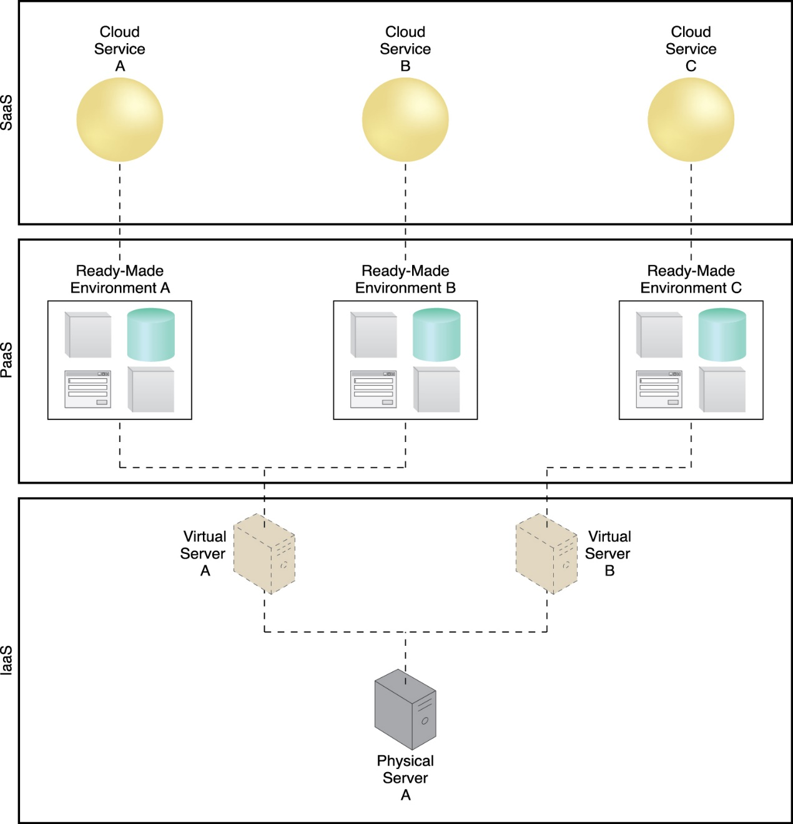
Combining Cloud Delivery Models
IaaSa + PaaS + SaaS
Ready-made environment provided by the PaaS environment can be used by the cloud consumer organization to develop and deploy its own SaaS cloud services that it can then make available as commercial products
Figure 4.16 A simple layered view of an architecture comprised of IaaS and PaaS environments hosting three SaaS cloud service implementations.

Slide 31
4.4. Cloud Deployment Models
A cloud deployment model represents a specific type of cloud environment, primarily distinguished by ownership, size, and access.
There are four common cloud deployment models:
Public cloud
Community cloud
Private cloud
Hybrid cloud

Slide 32
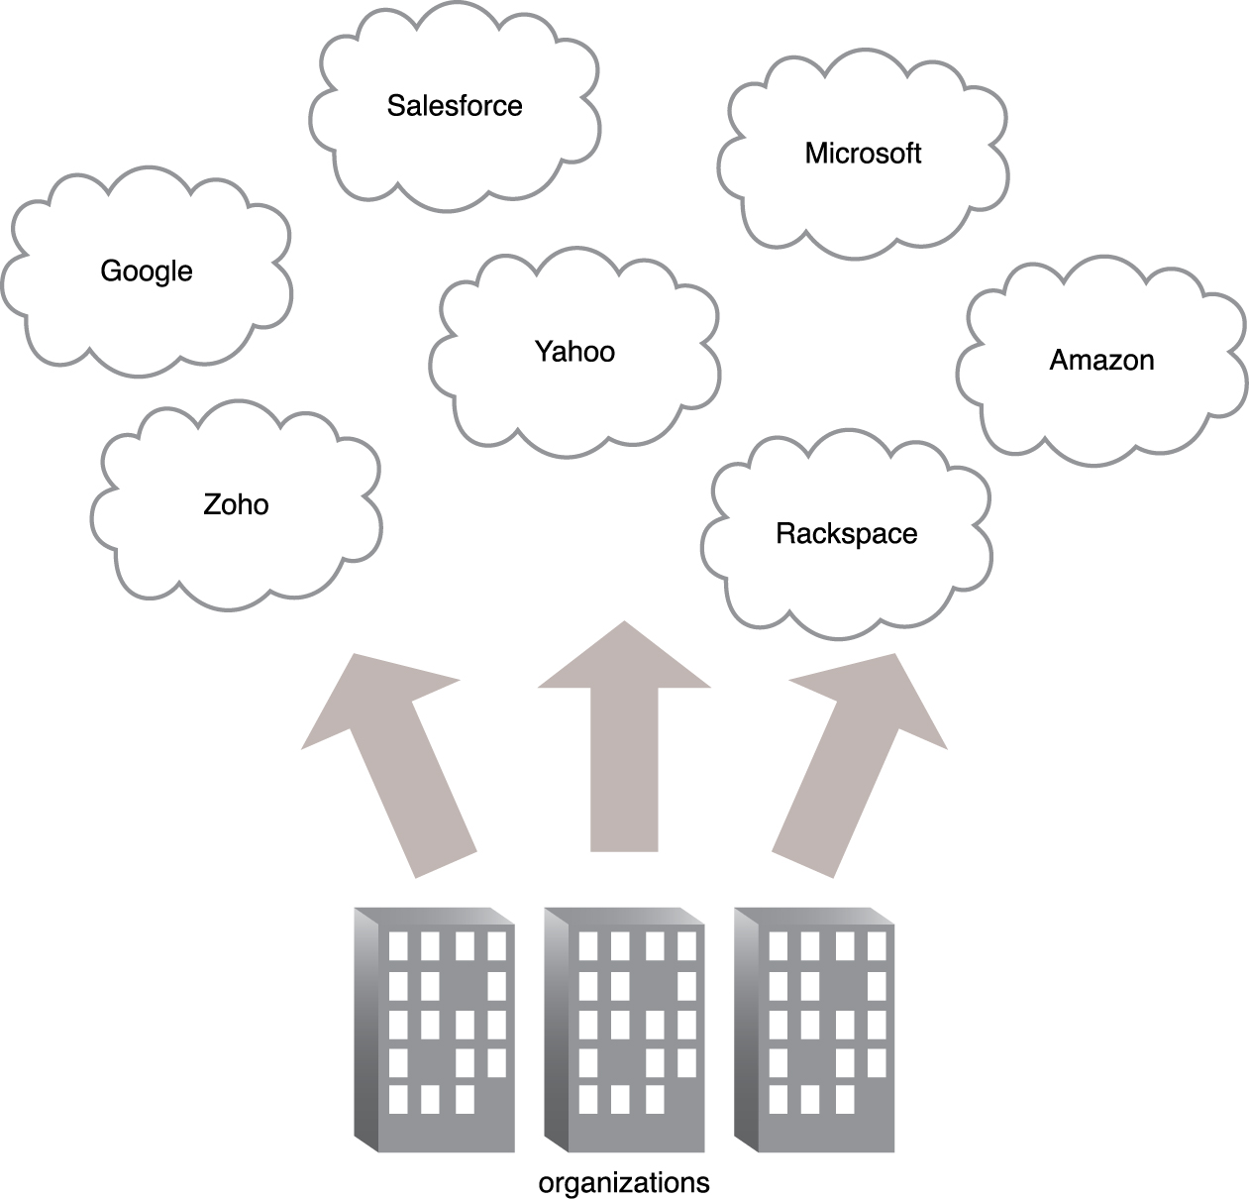
Public Clouds
A public cloud is a publicly accessible cloud environment owned by a third-party cloud provider. The IT resources on public clouds are usually provisioned via the previously described cloud delivery models and are generally offered to cloud consumers at a cost or are commercialized via other avenues (such as advertisement).
Figure 4.17 Organizations act as cloud consumers when accessing cloud services and IT resources made available by different cloud providers.

Slide 33
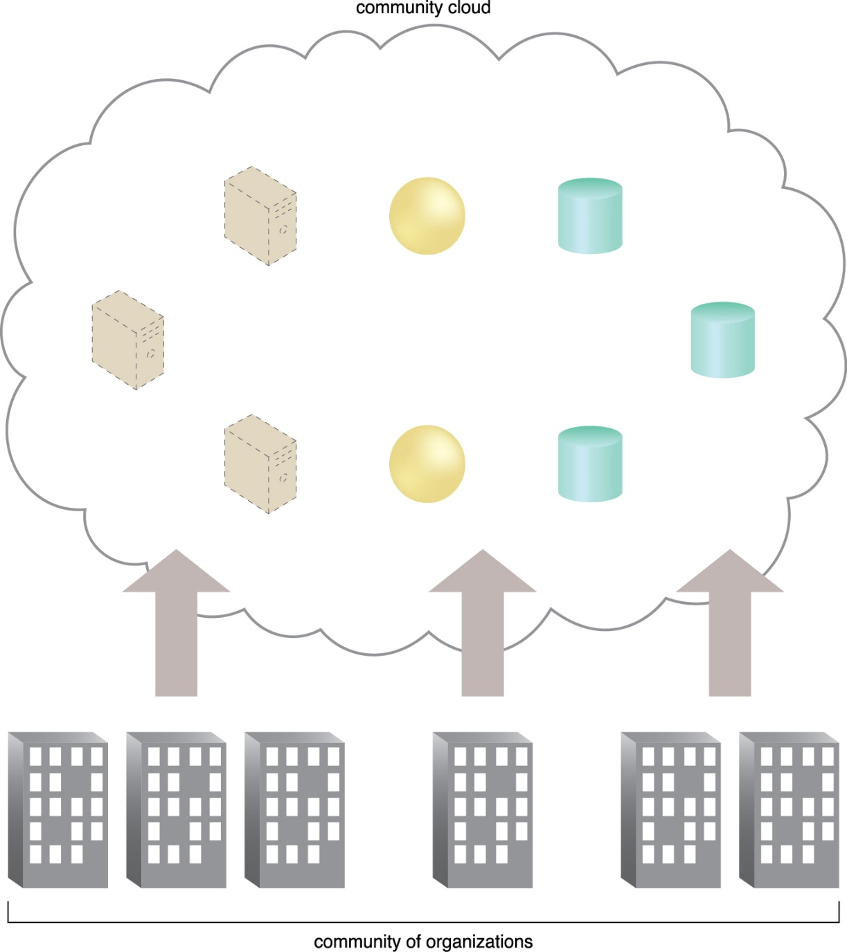
Community Clouds
A community cloud is similar to a public cloud except that its access is limited to a specific community of cloud consumers.
Figure 4.18 An example of a “community” of organizations accessing IT resources from a community cloud.

Slide 34
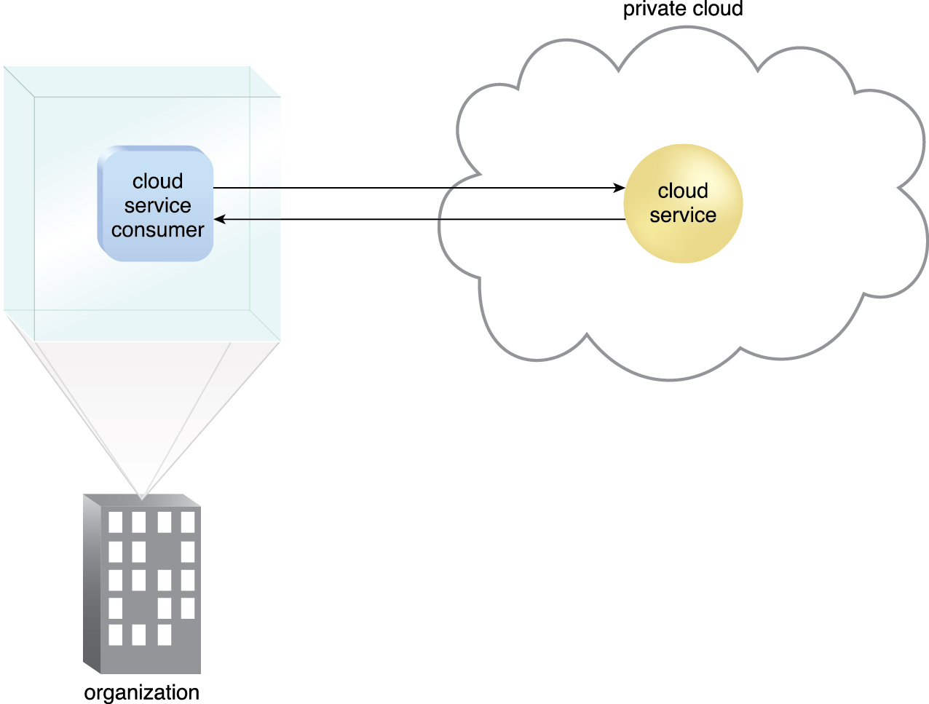
Private Clouds
A private cloud is owned by a single organization. Private clouds enable an organization to use cloud computing technology as a means of centralizing access to IT resources by different parts, locations, or departments of the organization.
Who would manage?
is “on-premises or cloud-based?
Figure 4.19 A cloud service consumer in the organization’s on-premise environment accesses a cloud service
hosted on the same organization’s private cloud via a virtual private network.

Slide 35
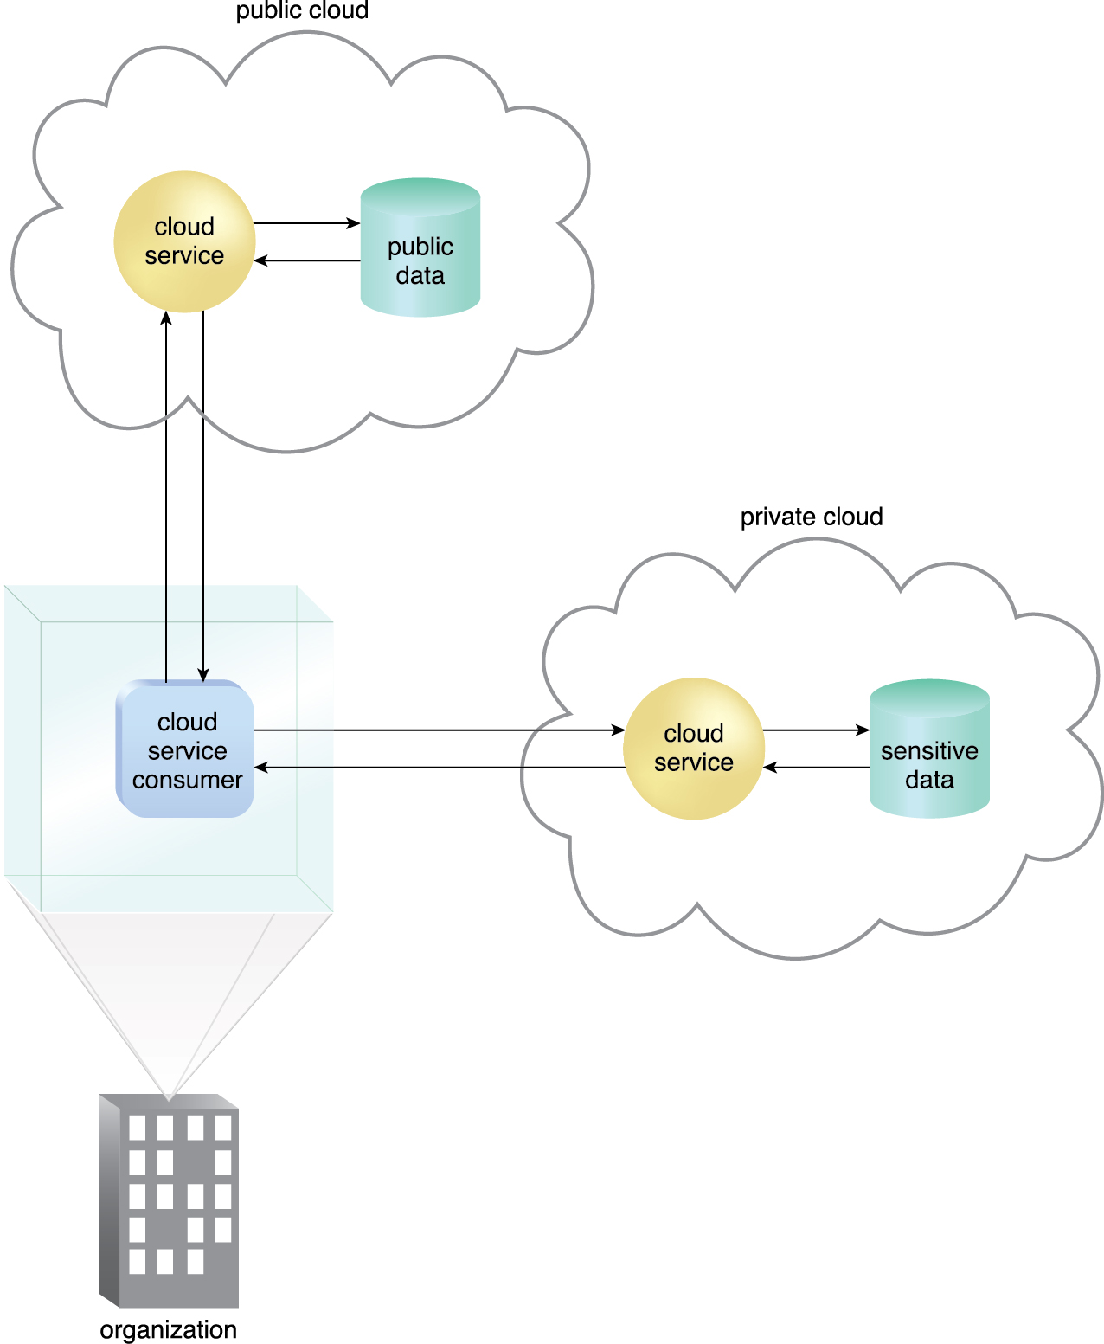
Hybrid Clouds
A hybrid cloud is a cloud environment comprised of two or more different cloud deployment models.
Figure 4.20 An organization using a hybrid cloud architecture that utilizes both a private and public cloud.

Slide 36
Other Cloud Deployment Models
Additional variations of the four base cloud deployment models can exist. Examples include:
Virtual Private Cloud – Also known as a “dedicated cloud” or “hosted cloud,” this model results in a self-contained cloud environment hosted and managed by a public cloud provider, and made available to a cloud consumer.
Inter-Cloud – This model is based on an architecture comprised of two or more inter-connected clouds.

Slide 37
Summary
Common roles associated with cloud-based interaction and relationships include the cloud provider, cloud consumer, cloud service owner, and cloud resource administrator.
An organizational boundary represents the physical scope of IT resources owned and governed by an organization. A trust boundary is the logical perimeter that encompasses the IT resources trusted by an organization.
On-demand usage is the ability of a cloud consumer to self-provision and use necessary cloud-based services without requiring cloud provider interaction. This characteristic is related to measured usage, which represents the ability of a cloud to measure the usage of its IT resources.
Ubiquitous access allows cloud-based services to be accessed by diverse cloud service consumers, while multitenancy is the ability of a single instance of an IT resource to transparently serve multiple cloud consumers simultaneously.
The elasticity characteristic represents the ability of a cloud to transparently and automatically scale IT resources out or in. Resiliency pertains to a cloud’s inherent failover features.

Slide 38
Summary (cont..)
The IaaS cloud delivery model offers cloud consumers a high level of administrative control over “raw” infrastructure-based IT resources.
The PaaS cloud delivery model enables a cloud provider to offer a pre-configured environment that cloud consumers can use to build and deploy cloud services and solutions, albeit with decreased administrative control.
SaaS is a cloud delivery model for shared cloud services that can be positioned as commercialized products hosted by clouds.
Different combinations of IaaS, PaaS, and SaaS are possible, depending on how cloud consumers and cloud providers choose to leverage the natural hierarchy established by these base cloud delivery models.

Slide 39
Summary (cont..)
A public cloud is owned by a third party and generally offers commercialized cloud services and IT resources to cloud consumer organizations.
A private cloud is owned by an individual organization and resides within the organization’s premises.
A community cloud is normally limited for access by a group of cloud consumers that may also share responsibility in its ownership.
A hybrid cloud is a combination of two or more other cloud deployment models.

Slide 40
Tutorial
Search Microsoft Azure free Trial from google.com
Learn how to create a VM/instance on Azure, hints: http://youtu.be/zvB7xjN1s0A
Connect to your instance from Lab59/54 and advise your lecturer for your completion.

